Slide 1
Temperature Controlled Dc Fan Using IC 741

Slide 2
Agenda
INTRODUCTION
APPLICATIONS
CIRCUIT DIAGRAM
WORKING PRINCIPLE
CONCLUSION

Slide 3
INTRODUCTION
The Circuit cools the Heat Generated in Electronics by Operating a DC Fan. When the Temperature reaches above the preset level, the circuit starts to work.Its Operation is Fully automatic and turns off when the temperature returns back to Normal. It Uses a 12V DC brushless fan used in Computers

Slide 4
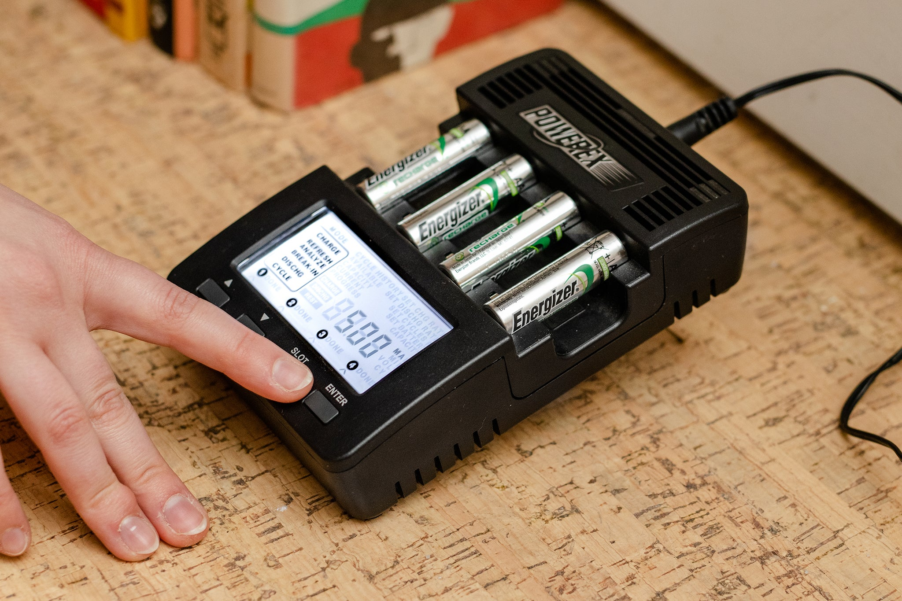

Applications
Power supply Circuits
Audio Amplifier Circuits
Battery Chargers
PC , Laptops etc..

Slide 5
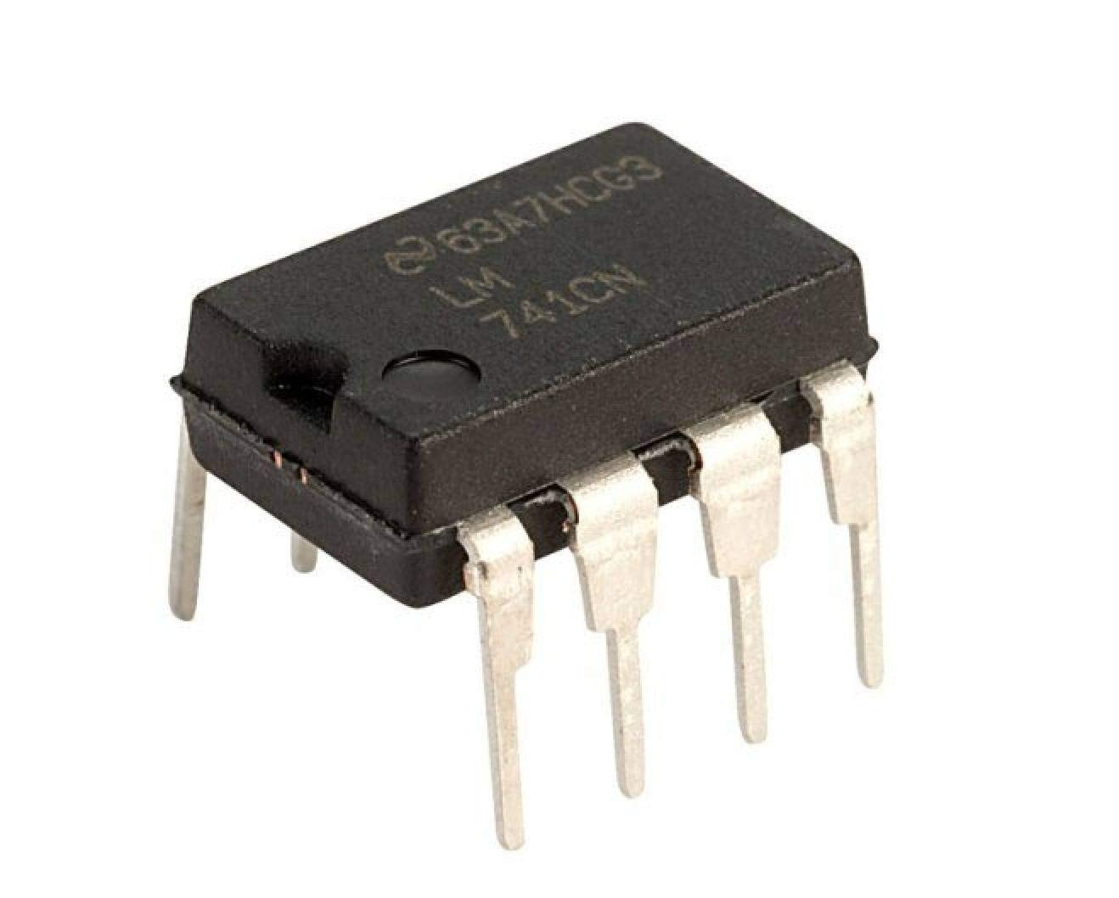
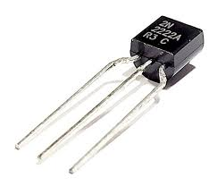
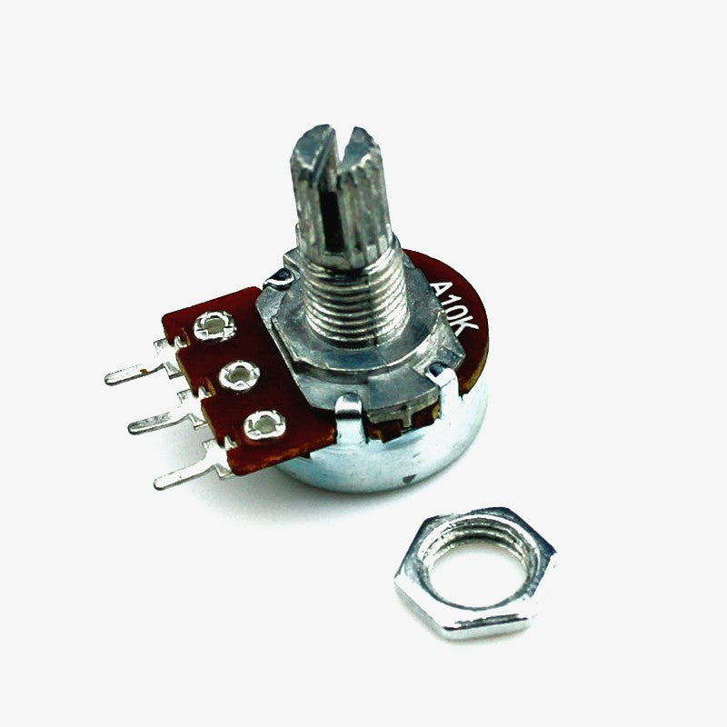
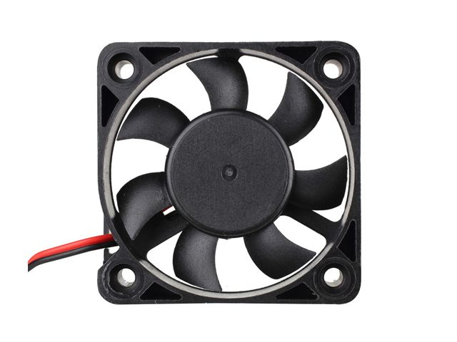
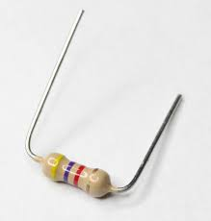
Components Used
Op-Amp IC LM741
NPN Transistor MJE3055
NTC Thermistor – 10K
Potentiometer – 10K
Resistor – 47Ohm , 4.7K
DC Fan ( Motor)
Power Supply – 5V

Slide 6
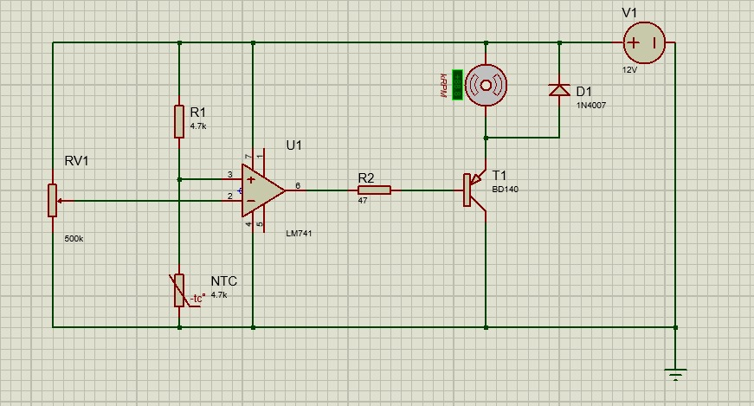
Circuit Diagram

Slide 7
Working Priciple
Here a 4.7K NTC Thermistor is used . IC741 Is used as a voltage comparator to switch on the DC fan ,
When the Temperature increases above the value set by VR, resistance of Thermistor decreases and the voltage at Pin3 decreases . As a result, output of IC becomes low to switch on T1 When the 10K NTC Thermistor senses heat its resistance will be decreased and it will power the circuit. A 10K variable resistor is used to set the circuit to activate the DC Fan on your desired temperature.

Slide 8
Conclusion
In conclusion, this circuit uses an IC741 voltage comparator and a 4.7K NTC thermistor to control a DC fan.
THIS IS USEFUL IN POWER SAVING AND Many more applications

Slide 9
Thank you
Team – 7
M AFNAN – ECE22023
N VIVEKANANDA - 22028
N ABHINAY – ECE22033
P MOHITH – ECE22054
K SASANK – ECE22055

